Slide 1
Principles of the Software Design
Course for Armenian-French University
Areg Melik-Adamyan
Petr Kurapov

Slide 2
Lecture 1: Course Introduction
Course for Armenian-French University (Lyon University)
Areg Melik-Adamyan
Petr Kurapov

Slide 3
Agenda
Overview
Course Logistics
Programming and Software Design
Engineering and Software Design
Software Design and Architecture

Slide 4
Course Overview
This course on the principles and methodology of software design and its applications in building software systems.
This is not about programming or how to use programming language to code an algorithms

Slide 5
Course Outline
Language of the Design
System Decomposition
Abstraction Creation
Synthesis
Building systems

Slide 6
Course Logistics
Course Policies and Schedule
Refer to the course page
Lots of readings and homework
Cheating will not help, the final exam is the most important.
All discussions and announcements will be on Discord

Slide 7
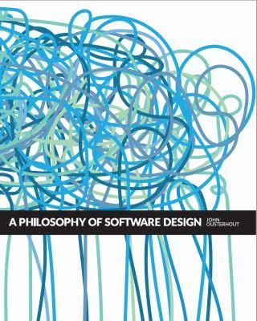
Textbook
There is no single book to cover everything.
The list of readings are in the syllabus.
Most of the stuff is a synthesis from books, articles and experience
This will be one of the many

Slide 8
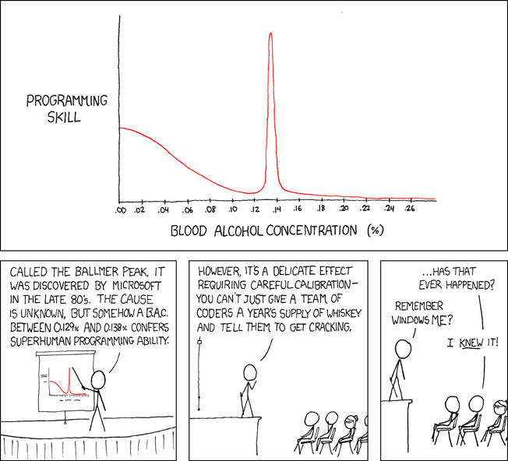
How to write great programs?
https://www.explainxkcd.com/wiki/index.php/323:_Ballmer_Peak

Slide 9
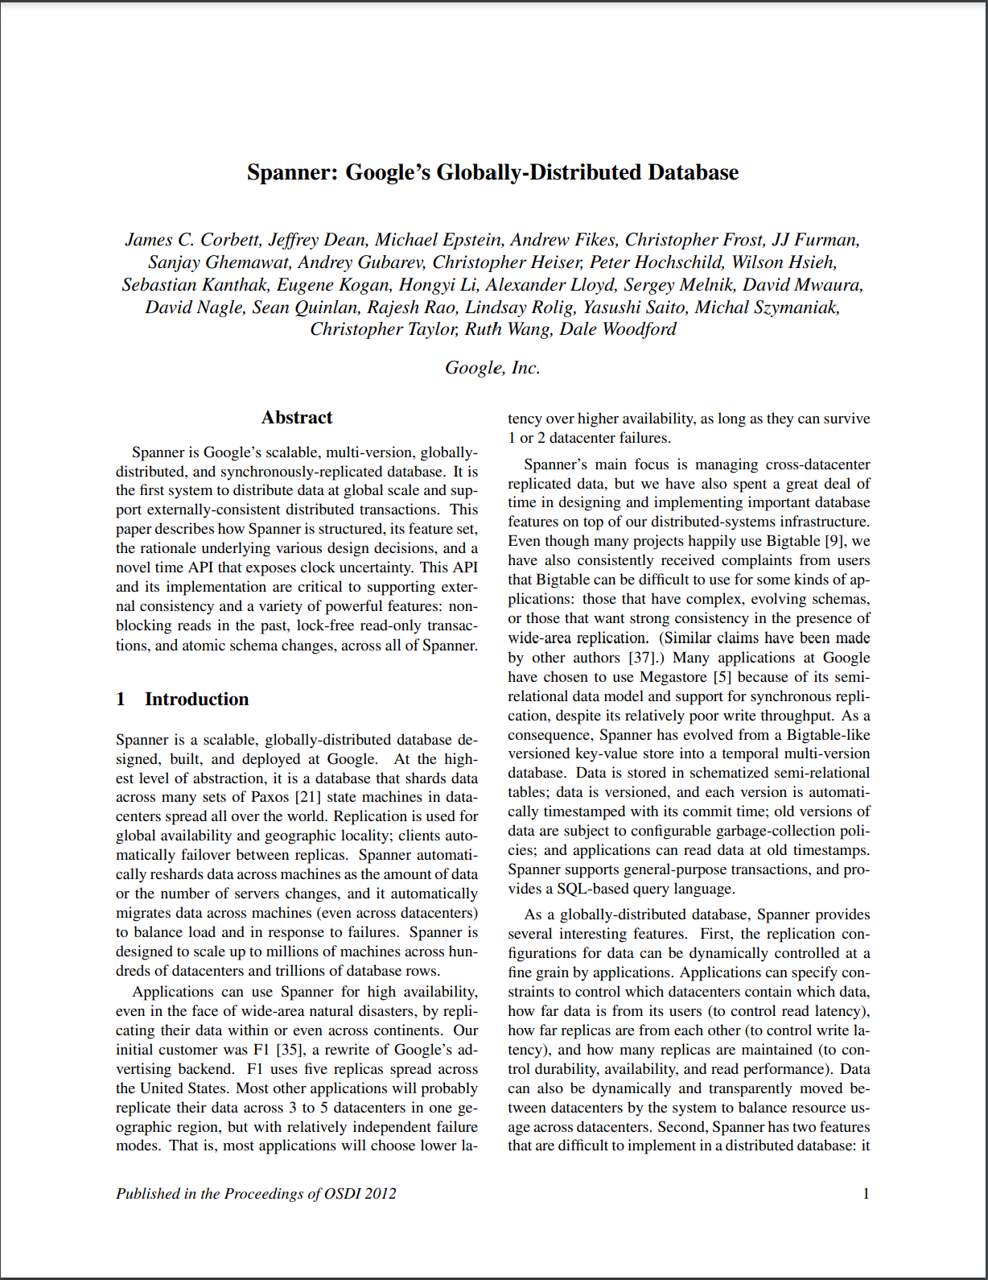
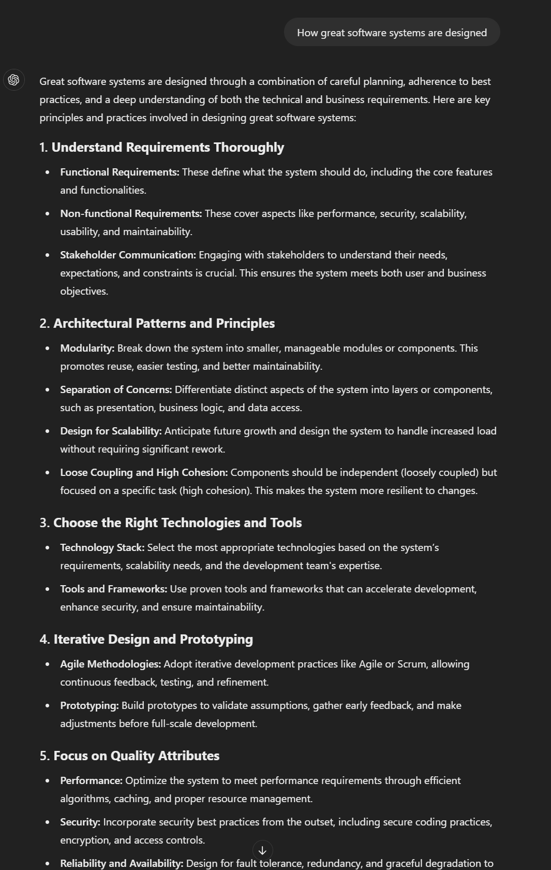
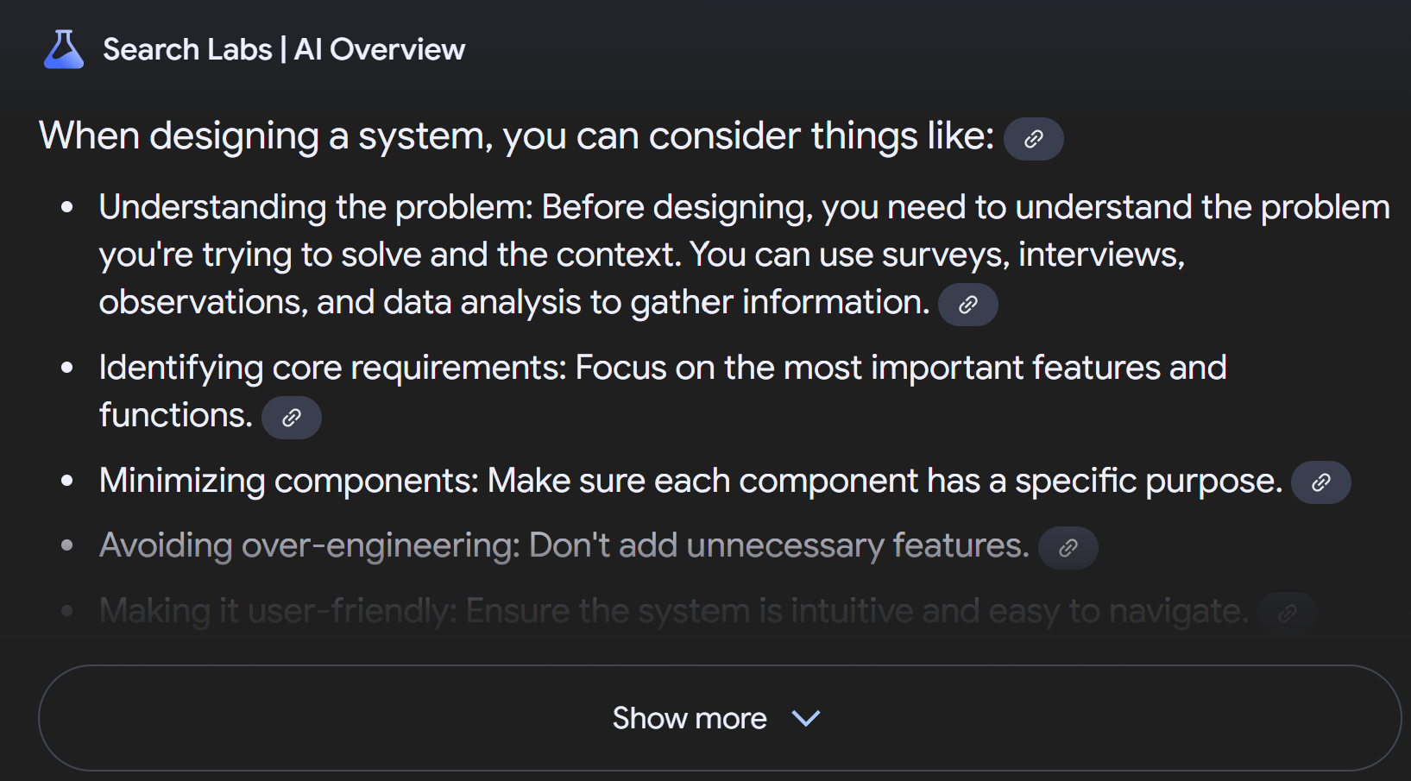
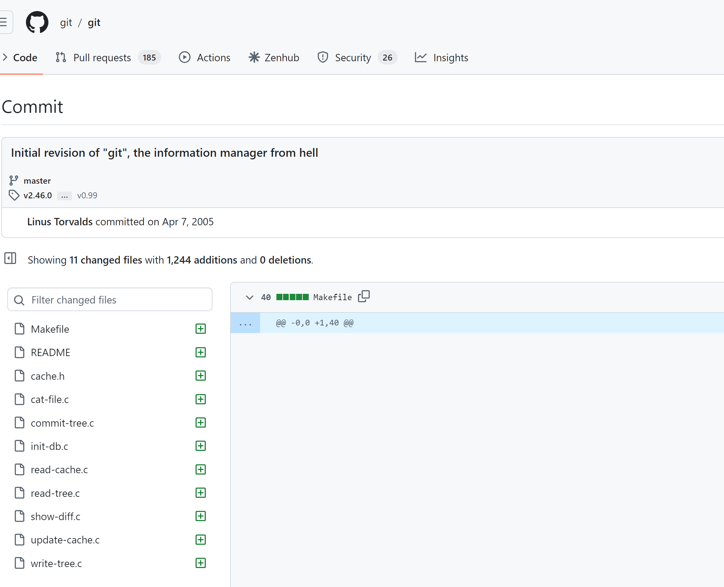
How to design great systems?

Slide 10
Great systems == great architects
How to become a great software programmer and architect?
Need to develop the appropriate mentality – the ability to step back and refine important from non-important stuff.
How are we going to learn that?
E.W.D Dijkstra, 1975 “The problem with today's mathematical curricula is that mathematical results are published and taught quite openly, but how mathematics is done is not published, not taught explicitly, and the student must pick it up by osmosis so to speak.”
We are going to study some designs.
But first, we need to start speaking the same “language of design”.

Slide 11
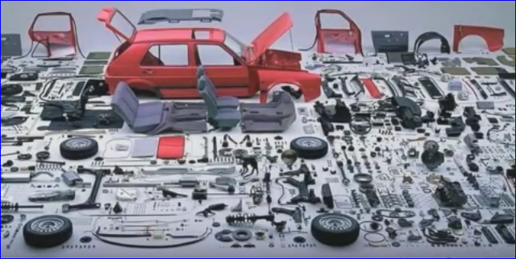
System Decomposition

Slide 12
It’s all About Complexity
“… But programming, when stripped of all its circumstantial irrelevancies, boils down to no more and no less than very effective thinking so as to avoid unmastered complexity, to the very vigorous separation of your many different concerns.” E.W.D, 1975.
What is software design/architecture?
Many definitions, will use many of them, one of most popular from SEI
“The software architecture is a set of structures needed to reason about the system, which comprise software elements, relations among them and properties of both.”
(Clements et al., 2010)

Slide 13
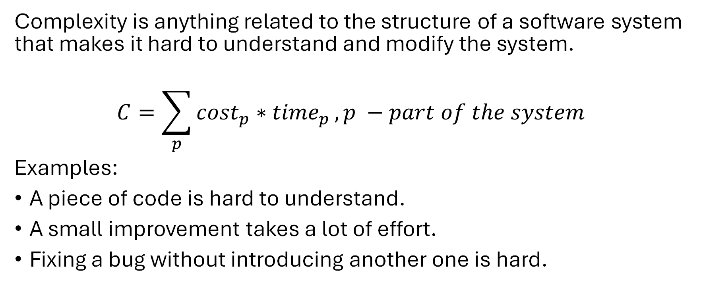
Complexity definition
Complexity is anything related to the structure of a software system that makes it hard to understand and modify the system.
$$C=\sum_{p}{{cost}_{p}∗{time}_{p}}, p −part of the system$$
Examples:
A piece of code is hard to understand.
A small improvement takes a lot of effort.
Fixing a bug without introducing another one is hard.

Slide 14
Symptoms of complexity
Change amplification
Example (#ifdef CUDA!!)
Cognitive load
Example (global variables, module dependencies – data mgr in hdk)
Lines of code is not a good measure!!
Unknown unknowns – something you need to know, but there’s no way of finding out what it is
Example (smth like a lack of dependency on a global-ish setting; options!! Update of the option by some rule that’s not apparent)

Slide 15
Causes of complexity
Dependencies – a piece of code cannot be understood or modified in isolation.
Example 1: method signature.
Example 2: serialization & deserialization.
Obscurity – important information is not obvious.
Example 1: variable name (time) or inadequate documentation.
Example 2: Error status & messages.
Complexity is incremental: thousands of small dependencies and obscurities introduced by current changes

Slide 16
Design and Architecture
Design is both verb and noun - process and result.
We will use Design and Architecture interchangeably.
Differ from Detailed-level design
What is driving design?
Decision to transform purpose – requirements (functional, non-functional, quality, constraints) are called architectural or design drivers.

Slide 17
Architectural Design
We talked about complexity, what else?
Decisions and intentions – forced by drivers.
Need to stay at a certain level of abstraction – not to get into detailed design.
What is detailed design?
Naming patterns, usage of Pthreads, usage of QUIC, etc.

Slide 18
Why is Software Design Important?
Design and architecture acts as the skeleton of a system.
Every system has an architecture. There is no single right architecture.
Architecture influences quality attributes.
External properties (latency, security, etc.) differently manifest in different skeletons.
Architecture is orthogonal to functionality!!!
E.g., you can build the same system as 3-tier, 2 tier or P2P.
Architecture constraints systems
Art to tame the complexity to have the right level of attributes.

Slide 19
When is Architecture Important?
Small solution space.
High risk of failure
Difficult quality attributes
New Domain
Product lines

Slide 20
But wait - Solution Space?
Need to take a step back
How do we get to solutions?
Drivers, drivers, drivers
Getting into the first formal concept in this course
The input driver -
Requirements!

Slide 21
Requirements Definition
Requirements describe the necessary functions and features of the system we are to conceive, design, implement and operate.
Performance
Schedule
Cost
Other Characteristics (e.g. lifecycle properties)
Requirements are often organized hierarchically
At a high level, requirements focus on what should be achieved, not how to achieve it
Requirements are specified at every level, from the overall system to each hardware and software component.
Critically important to establish properly!

Slide 22
Poor requirements examples: MCO
Mars Climate Orbiter (MCO) was launched by NASA on December 11, 1998
Intended to study Martian climate, weather and surface changes and act as communications relay back to Earth
However, disintegrated during orbit insertion on Sept 23, 1999 -> approach too close -> requirements not followed
Units confusion problem: Ground Software produced output in non-SI units (lbf-sec) instead of SI units: Ns
Contract between NASA and Lockheed Martin did specify SI-units This requirement was flowed down to the Software Interface Specification (SIS), but not verified later and not implemented properly
ftp://ftp.hq.nasa.gov/pub/pao/reports/1999/MCO_report.pdf

Slide 23
Poor requirements examples: Virtual Case File
One of the most well-known failed projects due to poor software requirements management is the FBI's Virtual Case File (VCF) system. This project, initiated in 2000, was meant to modernize the FBI's case management system. However, it was abandoned in 2005 after a huge financial investment, estimated at over $170 million, without delivering a usable system. Here are some key reasons for its failure, specifically related to software requirements management:
1. Unclear and Changing Requirements
The FBI's initial requirements for the system were vague, and as the project progressed, they kept changing. This lack of clarity made it impossible to develop a stable system architecture, and developers had difficulty tracking and responding to these shifting requirements.
2. Lack of Stakeholder Involvement
While the system was designed to serve FBI agents, there was inadequate involvement from the agents themselves in the early stages of gathering requirements. The developers and decision-makers did not fully understand how the agents worked or what features they truly needed.
3. Poor Communication and Documentation
Communication between the FBI, contractors, and stakeholders was inadequate, leading to misunderstandings about what the final product should look like. Additionally, documentation on requirements was either insufficient or out of date, making it difficult for teams to follow a clear development path.
4. Overly Complex Requirements
Some of the requirements that were eventually added to the project were overly complex and not necessary for the core functionality. This feature creep further complicated the system and led to delays, without improving the final product.
Outcome
After five years of effort, the VCF system was never fully functional. The project was scrapped, and the FBI had to start over with a new case management system, Sentinel, which was completed much later with lessons learned from the VCF failure.

Slide 24
Poor requirements examples
Another prominent example of a failed project due to poor software requirements management is the Denver International Airport (DIA) Automated Baggage Handling System. This project, initiated in the early 1990s finished in 2007.
Unrealistic Requirements and Deadlines
The initial requirements were overly ambitious, demanding a fully automated, city-wide baggage handling system that was highly complex. The timeline for the system’s completion was also highly unrealistic, especially considering the scale of the system. The original schedule gave the developers only two years to complete what would have taken much longer with better planning.
2. Inadequate Requirement Gathering
Stakeholders did not fully assess the scope or the complexity of the system, resulting in incomplete and imprecise requirements. There was also insufficient consultation with the airport’s engineers, airlines, and other key users who could have provided valuable insights into practical, operational needs.
3. Failure to Account for Changing Requirements
As construction of the airport progressed, the requirements for the baggage system changed, but the system was not flexible enough to handle these changes. For example, modifications to the airport’s design required changes in the system, but the development team struggled to adapt to these evolving needs.
4. Inadequate Testing and Maintenance Planning
There was poor planning for testing, and the system was rushed into trial without proper validation. As a result, the system failed spectacularly in tests, leading to bags being damaged, misrouted, and lost entirely. The complexity of the system also made it difficult to maintain, and these maintenance issues were not adequately addressed during the requirements phase.
5. Overconfidence in Technology
The project’s scope and complexity were exacerbated by over-reliance on advanced technology that was untested at this scale. The designers underestimated the difficulties in building an integrated system that handled different baggage types and scenarios, which led to frequent breakdowns during testing.

Slide 25

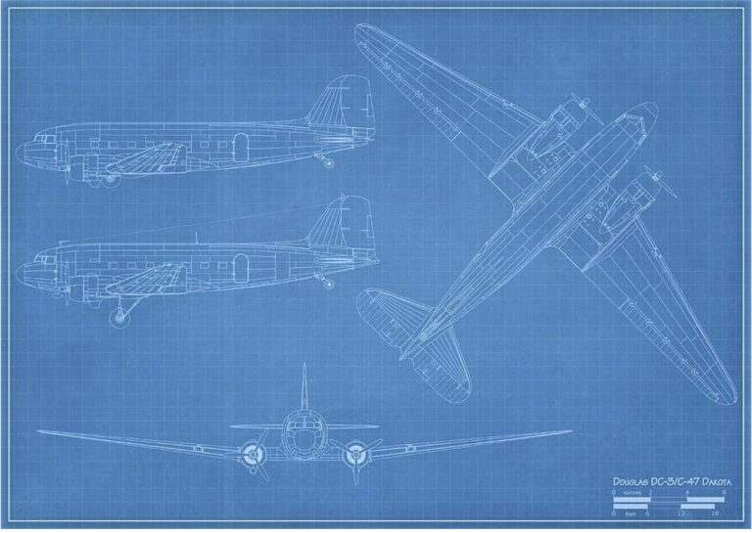
Good requirements example: DC-3
Requirements based on desired improvements to DC-2
Very simple 3-page RfP (McDonnell Museum) Phone call between Smith and Douglas
Key Requirements
Range: 1000 miles
Cruise Speed: 150 mph
Passengers: 20-30
Twin Engines
Rugged and Economical

Slide 26
Good requirements example: Basecamp
Clear and Focused Scope
Basecamp was designed to solve a specific problem: enabling small teams to manage projects and communicate effectively without overwhelming complexity.
User-Driven Requirements
The founders of Basecamp, originally running a web design company, built the tool out of their own needs for better project management.
Incremental Development and Simplicity
One of the guiding principles in Basecamp’s development was simplicity. The team emphasized developing the minimum viable product (MVP) first, with only the most essential features
Prioritization of Essential Features
The requirements focused on core functionality like to-do lists, project timelines, and file-sharing, without trying to compete with enterprise project management tools.
Agile and Customer Feedback Loops
Basecamp’s development followed an iterative approach, where user feedback was continuously gathered and used to shape future updates.
Avoidance of Feature Creep
Despite the temptation to add more advanced project management features to compete with larger, more feature-rich systems, Basecamp stuck to its principle of "less is more."

Slide 27
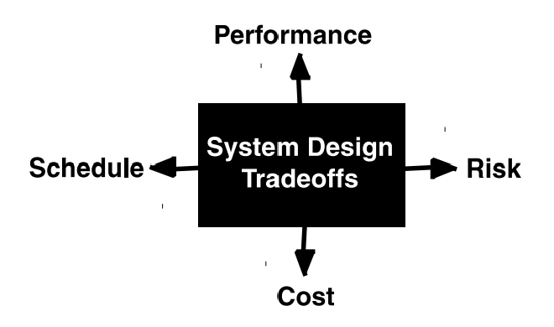
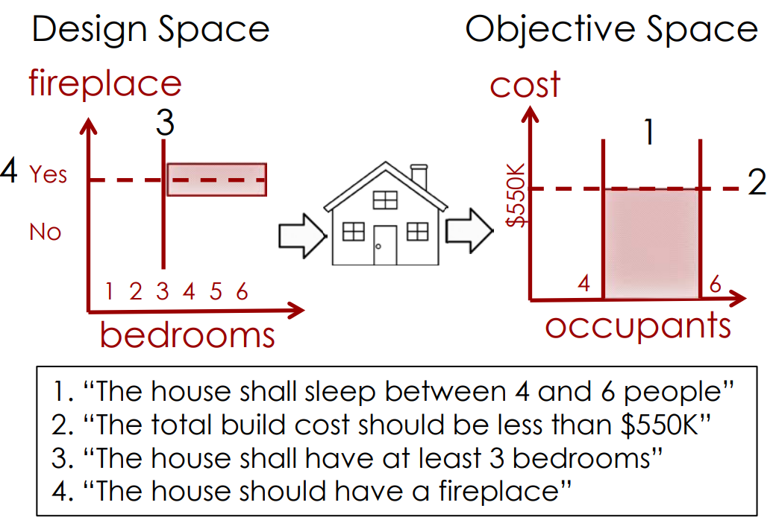
Requirements set constraints and goals in the design and objective space
When designing systems we always have tradeoffs between performance, cost, schedule and risk
“Shall” … Requirements help set constraints and define the boundaries of the design space and objective space
“Should” … requirements set goals once “shall” requirements are satisfied
Two main spaces:
Design Space – the things we decide as engineers
Objective Space – the things our systems/products achieve and what our customers care about

Slide 28
Quiz
Is there any difference in meaning between the words “Requirements” and “Specifications”?
No, they are essentially the same.
Yes, requirements are the input to the design process, while specifications are the output.
Yes, specifications include the requirements, but also contain other things.
I am not sure.

Slide 29
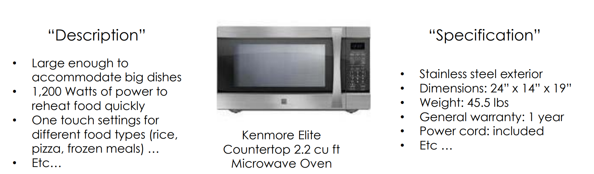
Requirements vs Specifications
Requirements specify what the system shall/should do:
Functions it shall perform
Specifications describe how the system is built and works.
The Form it is made of

Slide 30
Purpose of Technical Requirements Definition
The most important step the in the overall design process
Is used to transform the baselined stakeholder expectations (input) into unique, quantitative, and measurable technical requirements (output)
Requirements
Come in many flavors
Should be expressed as well-written “shall” statements that can be used for defining a design solution

Slide 31
Importance of Technical Requirements Development (1/2)
Establishes the basis for agreement between the stakeholders and the developers on what the product is to do
Reduces the development effort because less rework is required to address poorly written, missing, and misunderstood requirements.
Forces the relevant stakeholders to consider rigorously all of the requirements before design begins
Careful review can reveal omissions, misunderstandings, and inconsistencies early in the development cycle
Provides a basis for estimating costs and schedules
The description of the product to be developed as given in the requirements is a realistic basis for estimating project costs and can be used to evaluate bids or price estimates

Slide 32
Importance of Technical Requirements Development (2/2)
Provides a baseline for verification
Organizations can develop their validation and verification plans much more productively from a good requirements document.
The requirements document provides a baseline against which compliance can be measured.
The requirements are also used to provide the stakeholders with a basis for acceptance of the system.
Facilitates transfer of the product to new users.
Serve as a basis for later enhancement or alteration of the finished product.

Slide 33
Types of Requirements
Functional Requirements
These describe what the system should do and define the functionality that must be implemented. Features and capabilities.
Non-Functional Requirements (Quality Attributes)
Performance Requirements, Scalability, Reliability, Usability, Maintainability, Extensibility, Portability, Interoperability.
Technical Requirements
Technology Stack, Deployment environments, data storage, etc.
Operational requirements
Monitoring, recovery, backup,
Architectural constraints
Time, budget, standards, compliance
Interface
Other

Slide 34
Attributes of Acceptable Requirements
A complete sentence with a single “shall” per numbered statement
Characteristics for each Requirement Statement:
Clear and consistent – readily understandable
Correct – does not contain an error of fact
Feasible – can be satisfied within natural physical laws, state-of-the-art technologies, and other project constraints
Flexibility – Not stated as to how it is to be satisfied
Without ambiguity – only one interpretation makes sense
Singular – One actor-verb-object requirement
Verifiable – can be proved at the level of the architecture applicable
Characteristics for sets of Requirement Statements:
Absence of redundancy – each requirement is specified only once
Consistency – terms used are consistent
Completeness – usable to form a set of “design-to” requirements
Absence of conflicts – not in conflict with other requirements or itself

Slide 35
Requirements Decomposition, Allocation and Validation
Requirements are decomposed in a hierarchical structure starting with the highest level requirements.
These high-level requirements are decomposed into functional and performance requirements and allocated across the system.
These are then further decomposed and allocated among the elements and subsystems. This complete set of design-to requirements is achieved.
At each level of decomposition (system, subsystem, component, etc.), the total set of derived requirements must be validated against the stakeholder expectations or higher-level parent requirements.

Slide 36
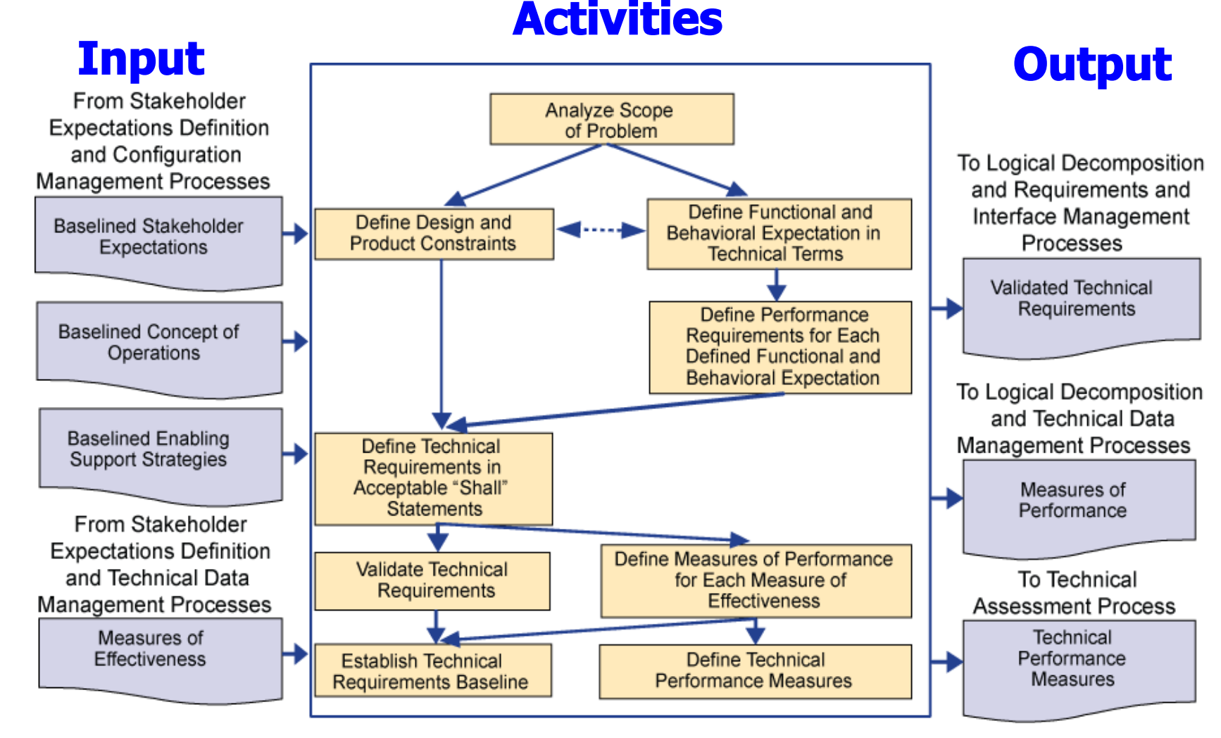
Example: NASA Process

Slide 37
Requirements Capture: Documents vs. Database
Where / how are requirements captured?
Low-cost “easy” solution: Create a document (e.g., in MS Word or Excel) to capture and revise the requirements. Use hyperlinks to link requirements.
This works okay for smaller projects with dozens or a few hundred requirements (e.g. about 3 levels of decomposition -> (7+/-2)^3 = 125 - 729
For larger projects with >1,000 requirements need to use a relational database
Commercial Tools, e.g. JIRA/Confluence, DOORS, Jama, are available (but can be expensive)

Slide 38
Example of hierarchical requirements
R1.0 The system shall fit into a volume not exceeding 1.0 m^3
R1.1 The system width shall be between 0.5m and 1.0m
R1.2 The system height shall be between 0.5m and 1.0m
R1.3 The system depth shall be between 0.5m and 1.0m
R1.0 The system shall have command line options to control execution
R1.1. The option –help should give the overall information about the system

Slide 39
Homework
Find the initial Git commit by Linus Torvalds, read the code, and build the technical requirements document. Is there enough information for the conceptual model of the initial design?
What was the problem?
What were the requirements?
What were the constraints?
What were the explicit design decisions made?
Need to write a paper answering these questions.
Extra points if you add – what is wrong with Git?

